Slide 1
Segregation of Races Within a Community
By: Zach Stept

Slide 2

Introduction
What is Segregation?
Analysis of segregation in communities
Can segregated communities live in harmony?

Slide 3
Background
U.S. Census allows for data to map racial segregation
an interactive map shows that people in cities such as Washington, D.C. mostly live in segregated neighborhoods even though they work in relatively diverse downtowns during the day. The visualizations also demonstrate that neighborhood segregation is increasing
Michael McLaughlin of Center for Data Innovation
Leads to
Gangs
Drug use
More wrongful convictions of murder, sexual assault, and drug use
Government forced segregation
New York CIty Housing Authority and Robert Moses
Cross Bronx Expressway
Housing developments put up by the city

Slide 4
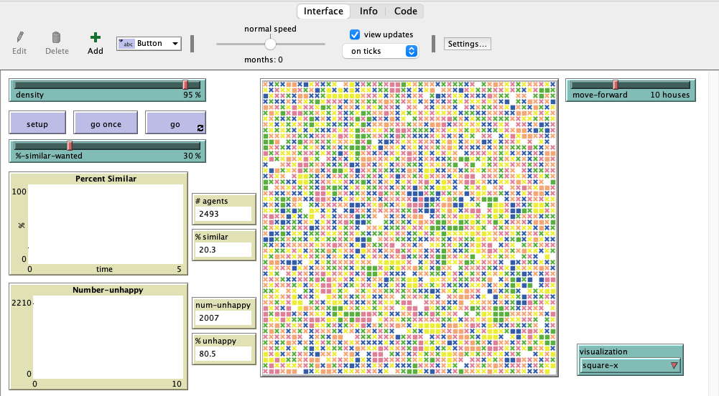
Methodology
Use of NetLogo’s Simulation model
Addition of 3 new patches and a slider
White, African-American, Asian, Hispanic, and others
Each tick represents 1 month
Use of data from simulations
Use of real life examples

Slide 5
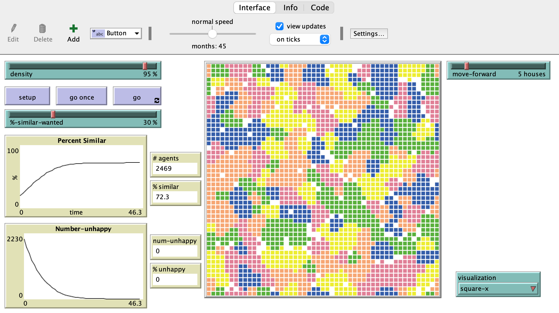
Results
A trend exists between the distance allowed to move (shorter distance, more time)
A trend exists between “%-similar-wanted”
Higher = more segregated
Lower = less segregated
The more the community wants to segregate the longer it will take for everyone to be happy
Example: Washington, D.C. from The Washington Post

Slide 6
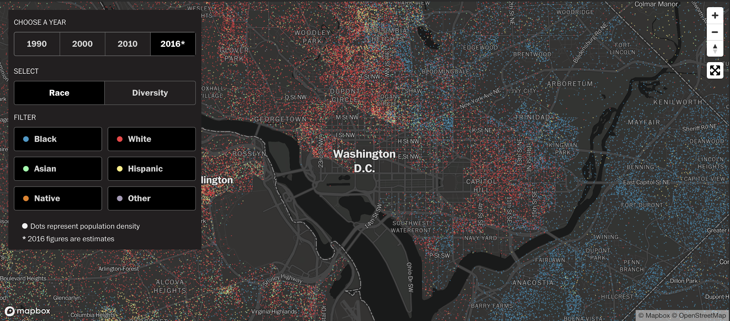
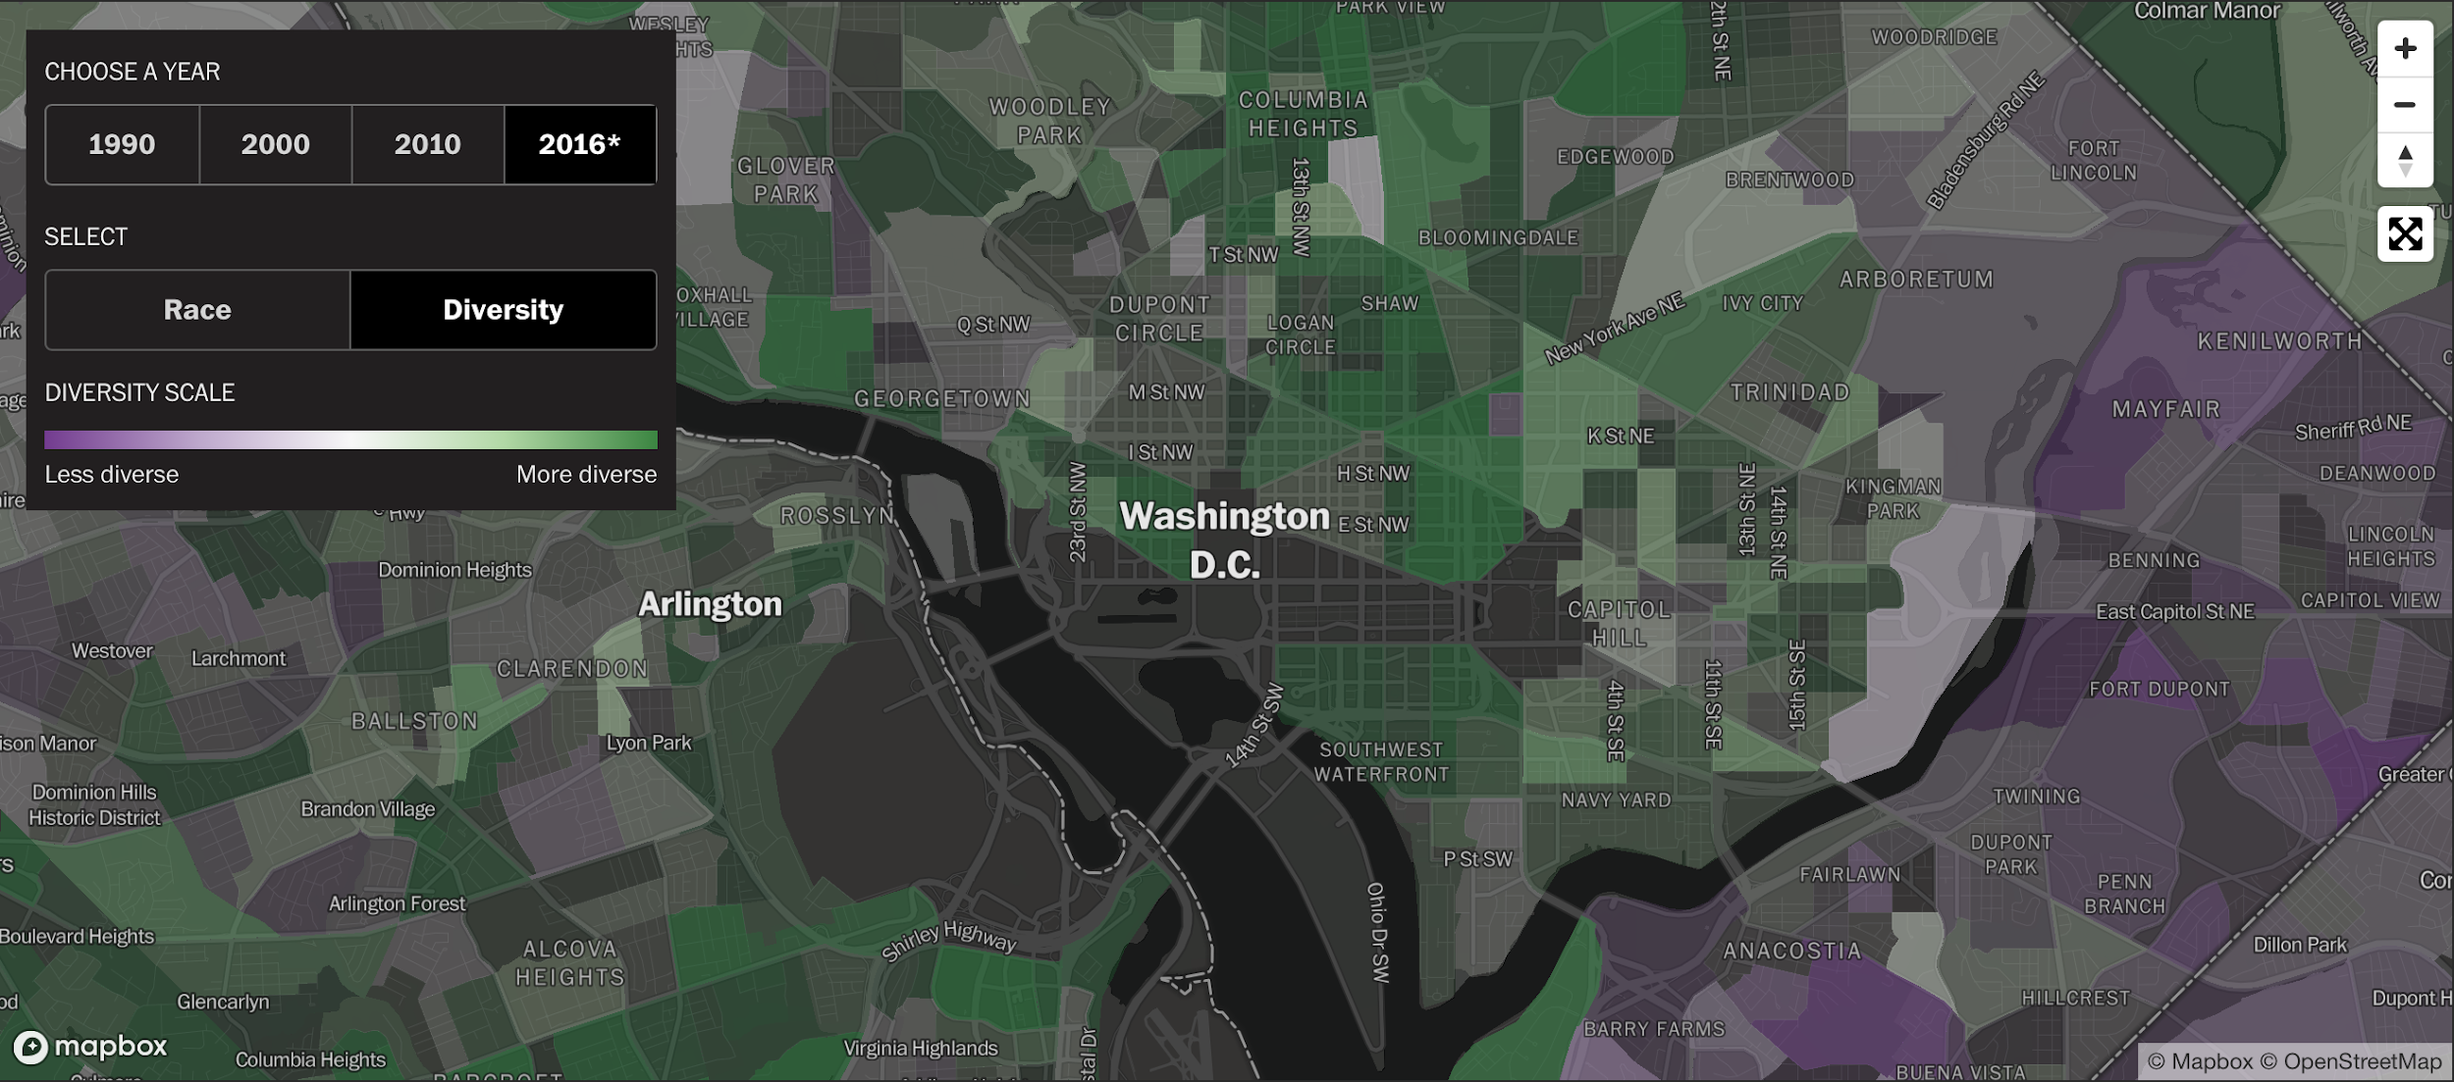
Results (cont’d)
Article: “America is more diverse than ever – but still segregated”
Contains maps of diversity and race in metropolitan areas
Makeup of Washington, D.C.
47% White-Americans
53% non-White racial groups
Up from 36% in 1990
Social climate effects moving

Slide 7

Discussion
The Model was effective in:
Finding factors that affect segregation
Percentage similarity: a big factor in determining segregation percentage
Finding trends and patterns
Analysing multiple model runs resulted in consistent data types
The Drawbacks:
Real life patterns
Social Politics
Economic policies regarding retail space

Slide 8
Summary/Conclusion
Research doesn’t make it possible to solve issues, but to understand patterns of possible issues
Easier to connect to real-life examples
Most people are unsatisfied with where they live and will continue to move until they are satisfied
Segregation mapping makes it easier to see patterns in how people are moving each year
NetLogo model makes it easier to see patterns in a perfect community

